Slide 1
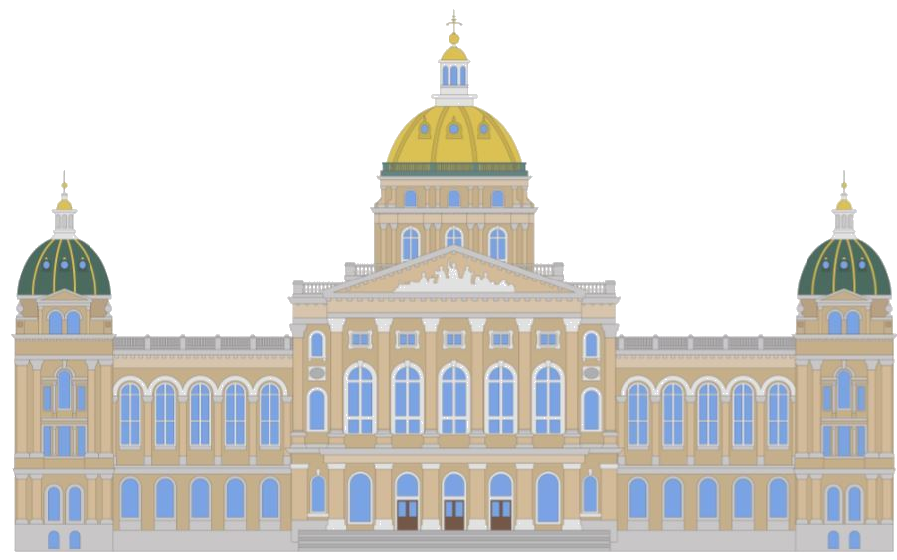
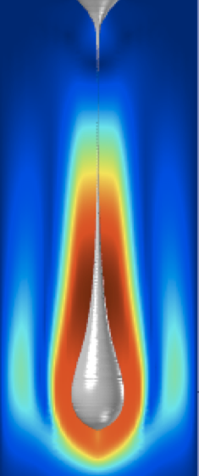
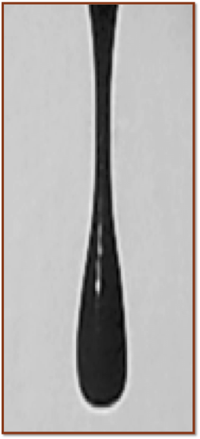
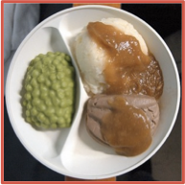
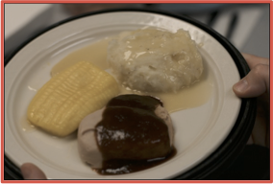
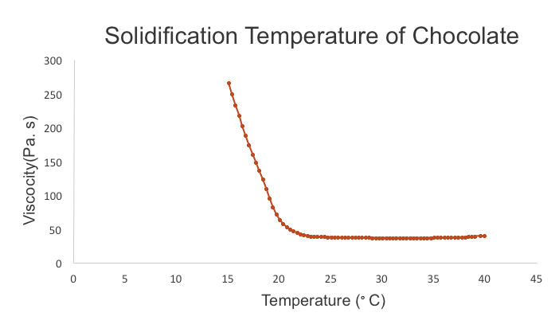
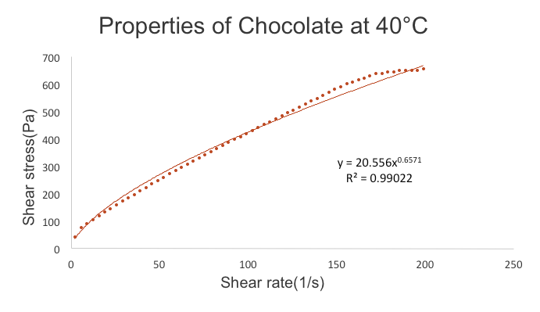
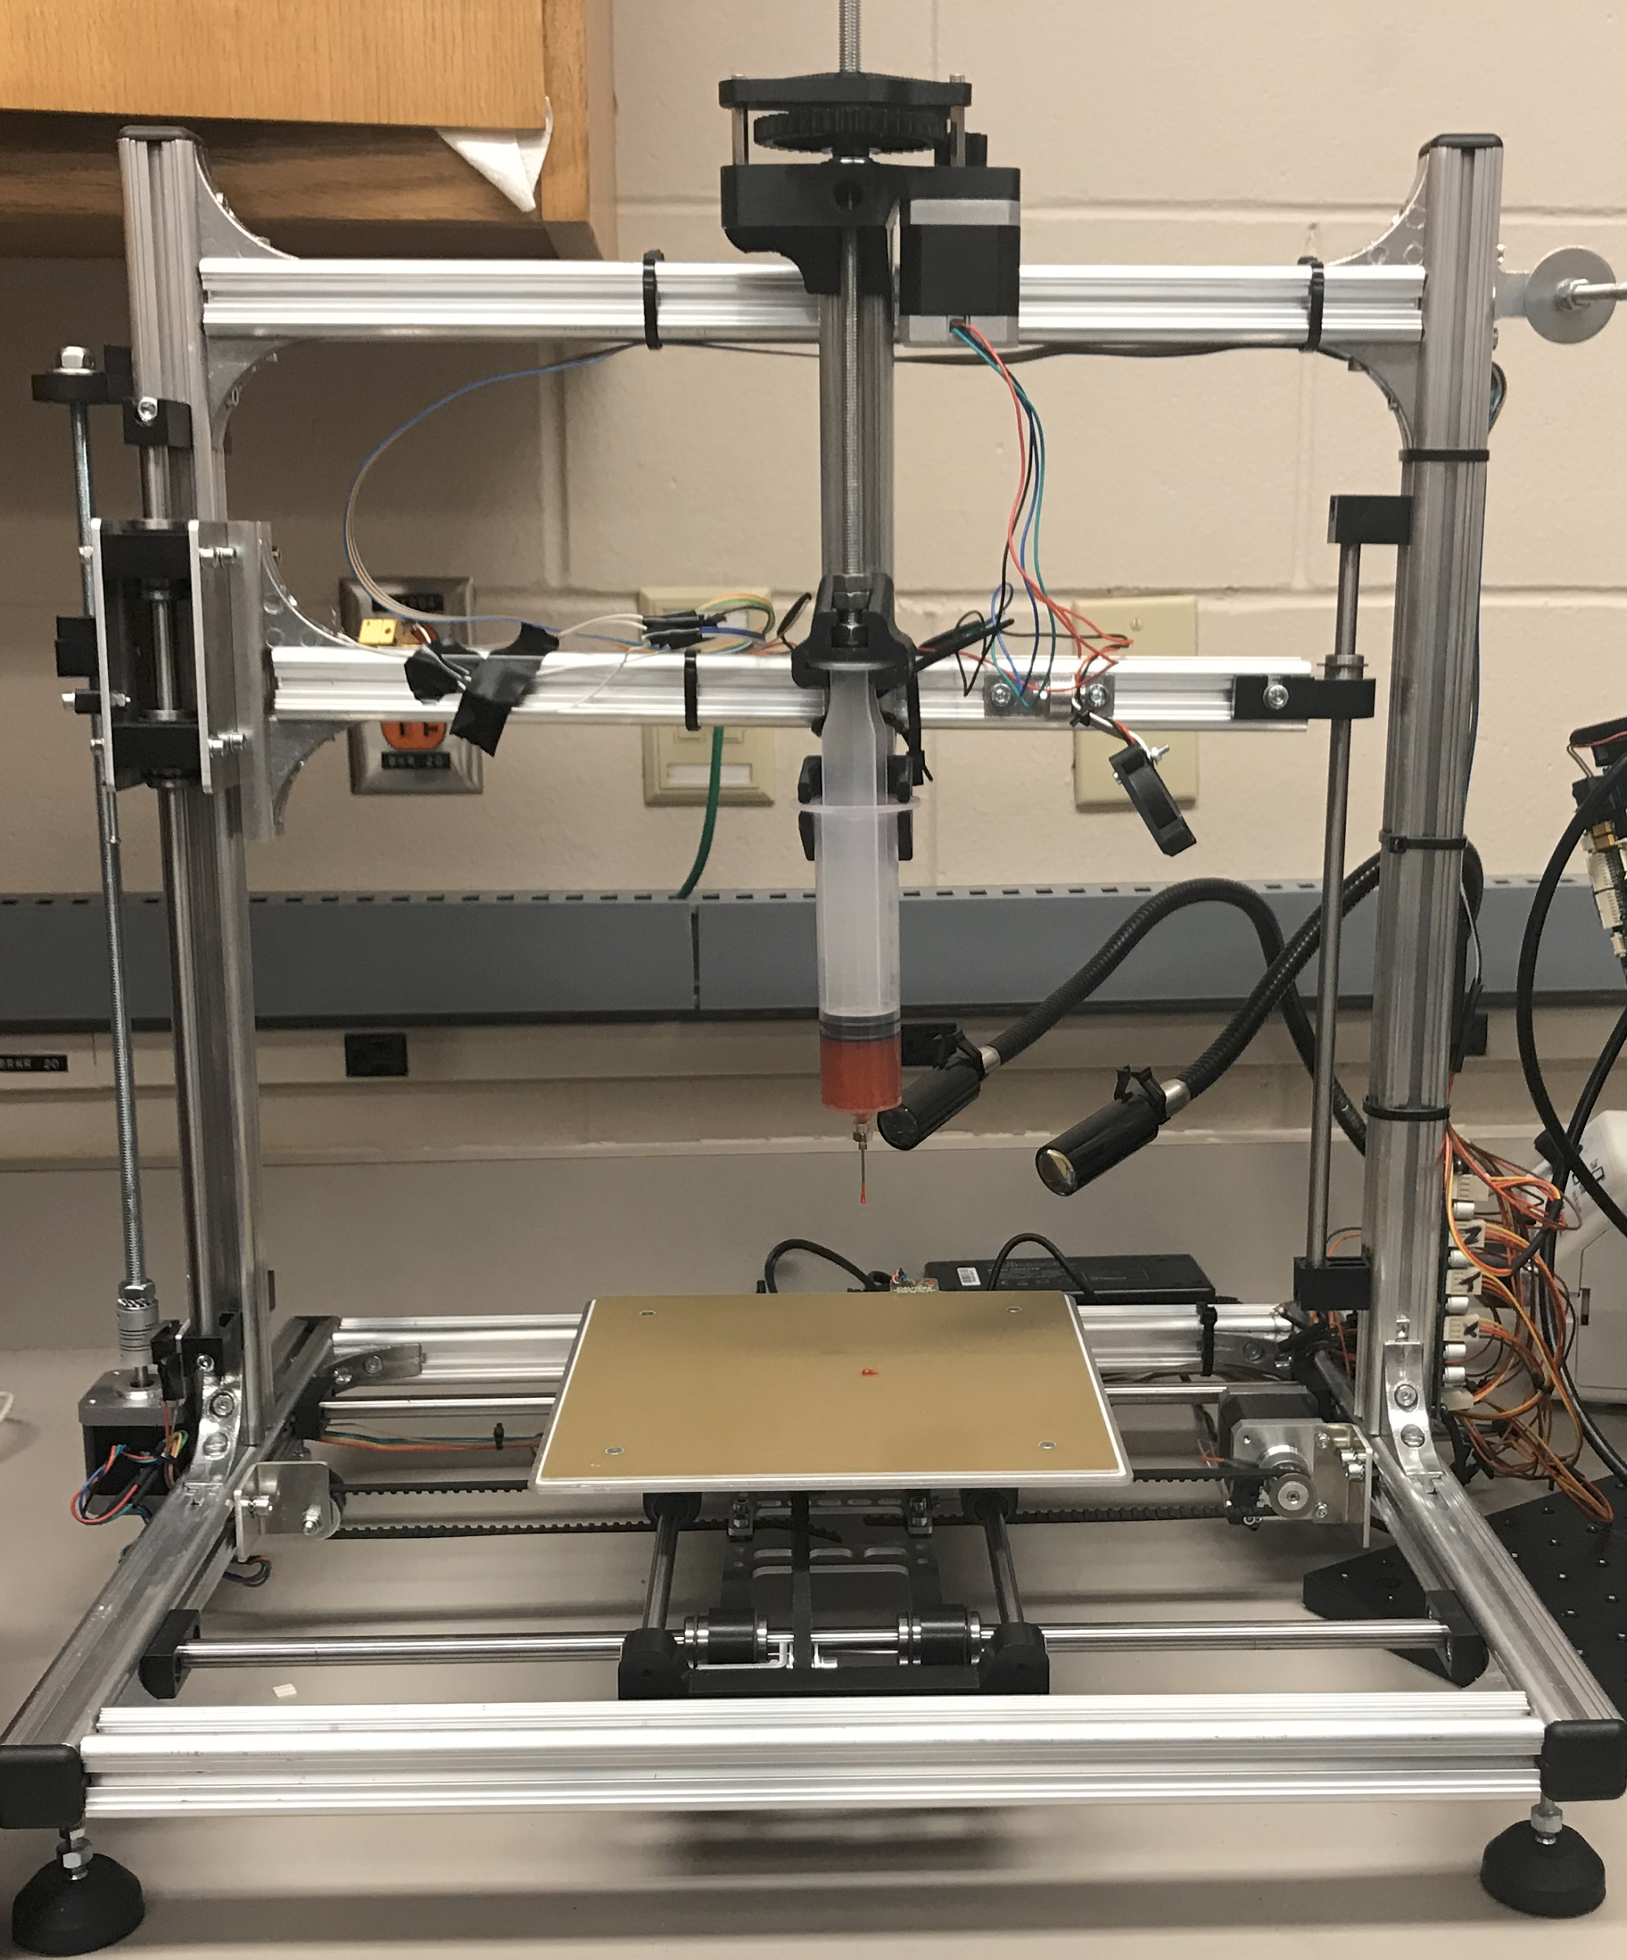
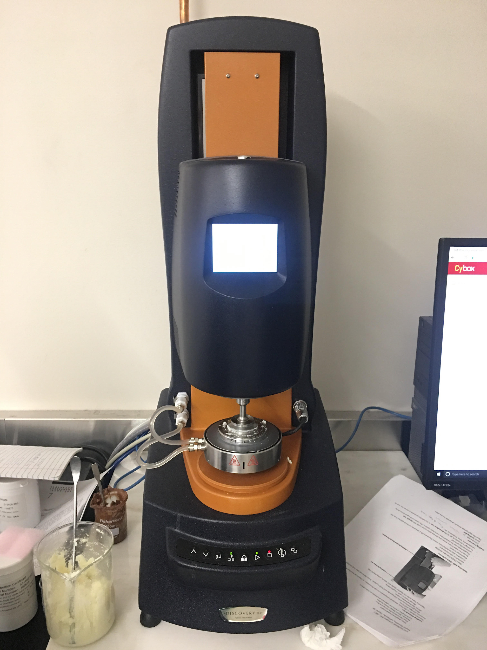
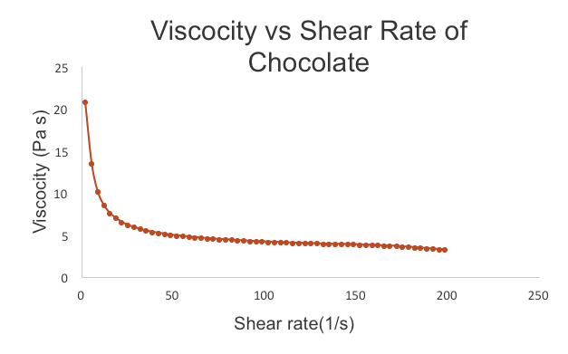

Flexible Electronics & Additive Printing Laboratory (FEAP)
In-situ Characterization of Additive Printing Laboratory (iCAP)
www.imse.iastate.edu/feap
Industrial and Manufacturing Systems Engineering
April 2018
Xiao Zhang, Tanner Spies, Kevin Lin, Eric Spahr, Xiaolei Shi¹* and Hantang Qin²* 1*: xshi@iastate.edu 2*:qin@iastate.edu
3D PRINTING APPLICATIONS FOR FOOD IN HOSPITALS
INTRODUCTION
Malnutrition, associated with inadequate food intake, affects 20-50% of hospital patients. This is due to lack of food variety and compromised flavor and texture
Current 3D printing technologies may be capable of preparing food with customizable nutritional values, flavors, and textures
The application of 3D printing for fabrication of hospital foods provides a new approach to fulfill each patient’s nutritional needs while providing an enjoyable meal
OBJECTIVE
Build a custom 3D printer that will be capable of printing food
Classify foods by viscosity to determine their printability
Work with local hospitals and nursing homes to obtain patient preferences and expectations
ENGINEERING CHALLENGES
3D printing food is not a well established field. To accommodate this we needed a fully customizable printer and open source software to run it - we chose a customizable 3D printer (Velleman®Inc, Texas) and modified it to our specific needs. Some of the issues encountered with the printer included:
Calibrating z-axis to account for height of extruding syringe
Modifying printer to accommodate extruding syringe
Retrofitting syringe with electrical heating tape
MATERIAL CLASSIFICATION
One important step in the development of food printing technology is determing rheological properties of foods
In order for a material to be printable, it must be viscous enough to be extruded through the syringe, yet able to maintain its shape once setting on the substrate
Properties that must be obtained include:
Viscosity
Solidifying temperature
Melting temperature
Viscoelastic properties represented by storage/loss modulus (G’ and G’’)
RESULTS
SIMULATION
By collecting the material properties of various foods, we can simulate using their droplet formation and flight pattern using COMSOL Multiphysics®
This eliminates the need to test print each material
SUMMARY
Food printing of certain foods is a feasible option to resolve nutritional deficiencies in food
Engineering issues include temperature control and customized hardware configuration
Once we obtain viscoelastic properties of a material, the printing of that material can be effectively simulated
FUTURE WORK
Data will be collected about the material properties of various foods
Investigate the use of organic material as supporting structure to allow for more complex geometry
We are currently looking for more hostpitals and nursing homes to partner with in the central Iowa region
ACKNOWLEDGEMENTS
We would like to thank the Iowa State University IMSE Undergraduate Research program, as well as the Iowa State University Department of Food Science and Human Nutrition
REFERENCES
Thomas, David R., et al. "Malnutrition in subacute care." The American journal of clinical nutrition 75.2 (2002): 308-313.
Simulation of HERSHEY’S chocolate droplet vs actual droplet
Current state examples of hospital food
The solidification properties of a material are an important aspect of its printability
This relationship shows how easily a fluid can be manipulated
Equipment used to produce and analyze specimens
Fluid flow is highly dependent on material viscosity
This work is supported by Iowa State University Undergraduate Research Assistantship (URA) program.

